Slide 1
Exploring BlueField-2 DPU as an Accelerator for Latency Sensitive Workloads
by
Hamed Seyedroudbari

Slide 2




About Me
PhD Student at Georgia Tech
Advisor: Alexandros Daglis
Research Interests
Datacenters, SmartNICs, Edge Computing
Optimizing tail latency for latency critical applications
Why should you care, how does this impact you?
Notes:
Bring compute closer to the data.
Now let me explain what tail latency is and maybe this will make a little more sense.

Slide 3



Inside the Datacenter
Pipeline of microservices
Very fine grained
Single-digit µs service times
Microservices are latency sensitive
Strict SLOs: care for tail (99th %) latency.
Google Query
Ad Ranking
Recommendation Systems
ML
Database Lookups
Response
Microservice
Overheads considerably affect service quality.
Notes:
Memory hierarchy, storage access, compute, OS scheduler, queueing
Systems built today have to be extremely optimized.
Emulate Microservice and Measure Performance Boost that you would potentially see with DPU as a co-processor.

Slide 4
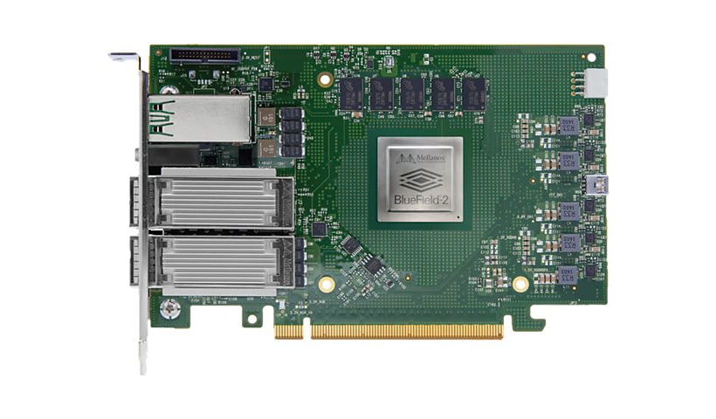
BlueField-2 DPU
Network Interface Card
8x Arm Cortex-A72 cores.
Clocked @ 2.5 GHz
1MB L2 cache per 2 cores
6 MB L3 cache
16GB DDR4
2x 100G port
100G per port, unidirectional
200G bidirectional (100G read, 100G write)
BlueField-2 DPU
Host
Server
BlueField-2 DPU
Arm Cores
Ethernet
Port 1
RDMA
PCIe Switch
Memory
Port 2
ConnectX-6

Slide 5
BlueField-2 DPU Operation Mode
Inline Accelerator
Bump in the wire
Look-aside Accelerator (Separate Host)
Network
Cores
BlueField-2 DPU
Host Server
Cores
Network
Host Server
BlueField-2 DPU

Slide 6
System Requirements
High Throughput & Message Rate
Low Latency Data Movement
RDMA Microbenchmark
Data movement bypasses kernel network stack
Network stack offloaded onto NIC hardware
Places message in host’s memory
Application
Client
Server
Memory
Memory
Socket API
RDMA Verbs API
Sockets
Kernel
TCP/UDP
Kernel Bypass
IP
NIC
Notes:
Goal of the internship was to push the limits on the Arm cores of the DPU and analyze how much throughput they can sustain and see how they would hold up if they were to process a latency critical workload.
And see if it can be a viable candidate for processing these types of workloads.

Slide 7
RDMA Microbenchmark
Emulates microservice
n client cores
n-1 load generating client threads
1 latency measurement thread
DUT responds with an echo
Memory
Memory
Network
Cores
Cores
Load
Generating
Client
DUT
(i.e. Server, DPU)
Notes:
Goal of the internship was to push the limits on the Arm cores of the DPU and analyze how much throughput they can sustain and see how they would hold up if they were to process a latency critical workload.
And see if it can be a viable candidate for processing these types of workloads.
What is the testbed which we run this on

Slide 8
Testbed Setup
Cores
Load Generator
Memory
Host Server
Memory
BlueField-2 DPU
Arm Cores
Ethernet
Port 1
Cores
RDMA
PCIe Switch
Memory
Host Client
Port 2
ConnectX-6
What is the max packet rate the BlueField-2 DPU can sustain?

Slide 9
Client Send Rate
Network Path
Can client generate enough load to stress DPU?
30.8 M msgs/sec
Network is not the bottleneck.
Peak rate supported by the network is 145M msgs/sec.
Cores
Memory
Host Server
Memory
BlueField-2 DPU
Arm Cores
Ethernet
Port 1
Cores
RDMA
PCIe Switch
Memory
Host Client
Port 2
ConnectX-6
Notes:
15.4 MRPS * 2 * 86B * 8 = 21.2 Gbps

Slide 10
Can the DPU’s Arm Cores Keep Up?
Network Path
BF-2 DPU
Can DPU keep up with client’s send rate?
20.2 M msgs/sec
Network is not the bottleneck.
Cores
Memory
Host Server
Memory
BlueField-2 DPU
Arm Cores
Ethernet
Port 1
Cores
RDMA
PCIe Switch
Memory
Host Client
Port 2
ConnectX-6
Notes:
10.1 MRPS * 2 * 86B * 8 = 13.9 Gbps

Slide 11
BF-2 DPU as Message Forwarder
Network Path
Max Sustainable Throughput
Are we saturating the network?
9.52 M msgs/sec
Cores
Memory
3
Host Server
Memory
BlueField-2 DPU
Arm Cores
Ethernet
Port 1
Cores
RDMA
PCIe Switch
Memory
Host Client
Port 2
ConnectX-6
Recv Msg from DPU Core
5
egress
ingress
Send Msg to DPU Core (RR Fashion)
1
4
Fwd Msg to Origin Client Core
egress
ingress
Fwd Msg to Server Core (RR Fashion)
2
Notes:
4.76 MRPS * 2 * 86B * 8 = 6.5 Gbps

Slide 12
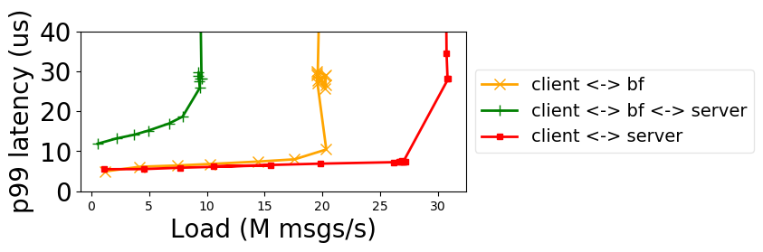
Putting it all together
BF-2 is the system bottleneck
Its throughput drops by ½ as a message forwarder.
As an application co-processor it can theoretically boost system throughput by 66%
Additional compute cores.
SLO
Notes:
Memcpy leads to throughput drop
30% is theoretical – describe how you get it.

Slide 13
Conclusion
BF-2 Arm cores are not apt for real-time data processing at line rate (100G).
Can be a great application co-processor.
Future Work
Configure/customize DPU Accelerators for line rate processing.
Notes:
Uncritical tasks: Route computation, partition discovery, etc.

Slide 14


Huge thanks to …
Pavel Shamis (Pasha)
Luis Peña
Alexandre Ferreira
Jon Hermes
Kurt Lorenzen

